Slide 1
Rajalakshmi Engineering College
An Autonomous Institution
Chennai-602105

Slide 2


ALGORITHM
SPECIFICATION

Slide 3
EXAMPLE PROBLEM
FINDING GCD
INPUT: Integers m and n
OUTPUT: Largest Integer that divides both
Consecutive Integer Checking
Euclid’s Algorithm
Middle School Procedure

Slide 4
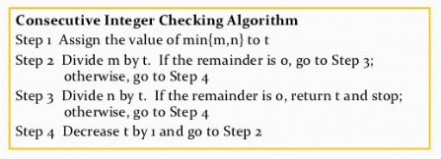
Consecutive Integer Checking
t ← min (m ,n)
if m % t = 0 goto 3,
else goto 4
3. if n % t = 0 return t,
else goto 4
4. t ← t - 1
5. goto 2

Slide 5
Consecutive Integer Checking
Example: gcd(10,6) = 2
t | m % t | n % t
6 | 10 % 6 = 4
5 | 10 % 5 = 0 | 6 % 5 = 1
4 | 10 % 4 = 2
3 | 10 % 3 = 1
2 | 10 % 2 = 0 | 6 % 2 = 0
2 is the GCD, since m % t and n % t are zero.

Slide 6
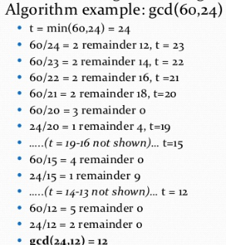
Consecutive Integer Checking
Example: gcd(60,24) = 12
PERFORMANCE WILL BE WORSE
12 is the GCD, since m % t and n % t are zero.

Slide 7
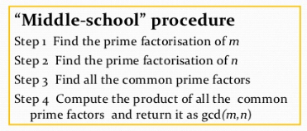
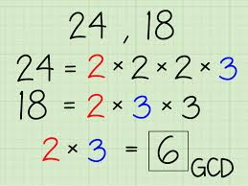
Middle School Procedure
Algorithm is Ambiguous

Slide 8
Algorithm is Ambiguous
Middle School Procedure
Need an algorithm for prime factorization to make middle-school procedure into an algorithm
As well as need an algorithm to find common prime factors.
INSTRUCTION ARE NOT CLEAR

Slide 9
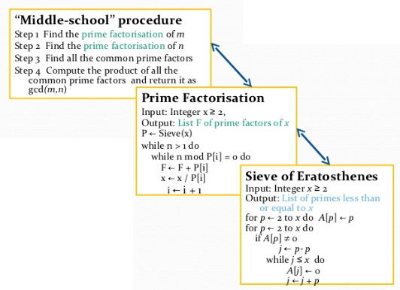
Middle School Procedure

Slide 10
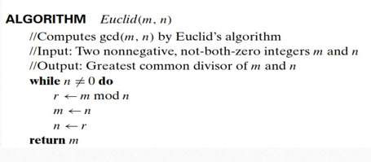
Euclid’s Algorithm

Slide 11
Finding the GCD of 24 and 9
Euclid’s Algorithm
M | N | R
24 | 9 | 6
9 | 6 | 3
6 | 3 | 0
3 | 0 | stop
So, 3 is the GCD of 24 and 9.

Slide 12
Each step of an algorithm must be unambiguous.
The same algorithm can be represented in several different ways. (different pseudo-codes)
Algorithms for the same problem can be based on very different ideas and can solve the problem with dramatically different speeds.
Conclusion

Slide 13


